Slide 1

SEO Analysis

Slide 2
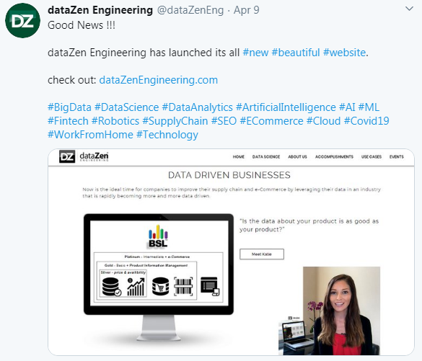
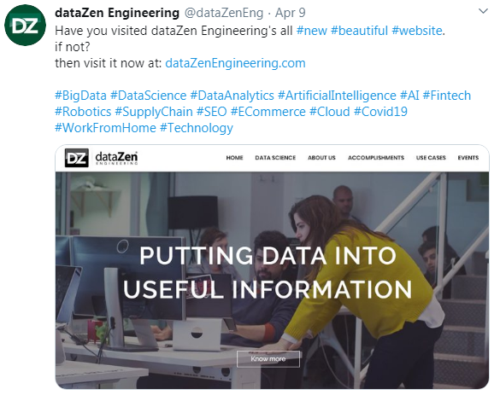
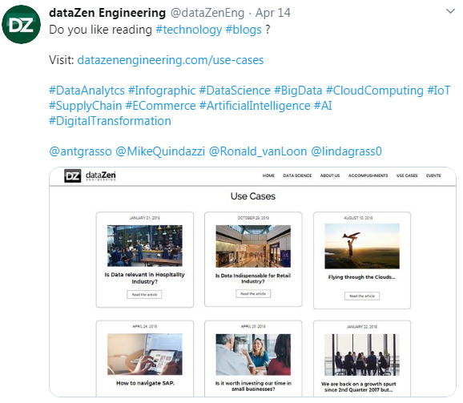
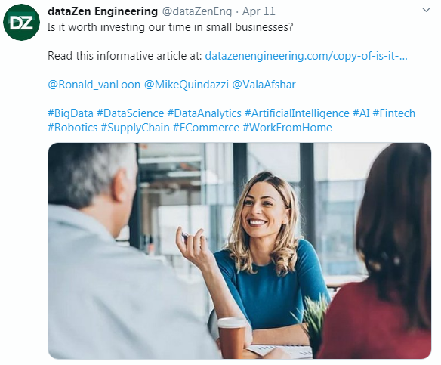
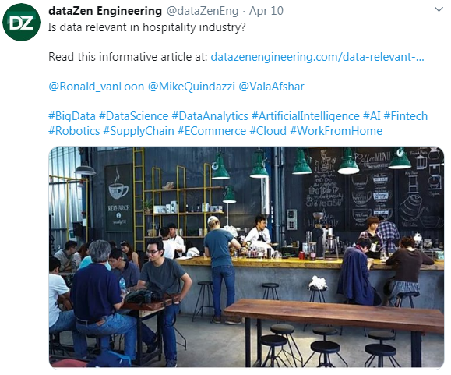
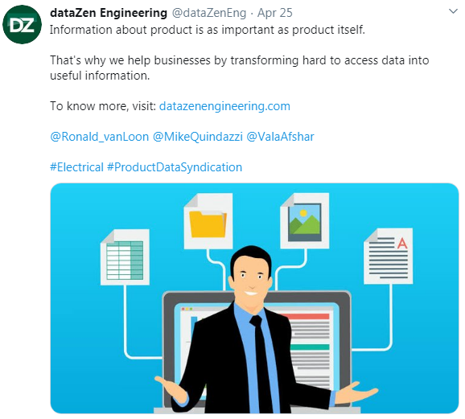
Although we are continuously promoting our website on social media but for more website visits we need to focus on SEO.

Slide 3
After some SEO research and analyzing our competitor's strategy (like Distributor Data Solutions - DDS), we found that we need to focus on some factors by which we can increase our website visitors. Website is like a real life person in the web world. It has to be good itself (good content) and it has to make relationship with other websites. Following are the factors which decide the credit of a website in the web world.
Topics :
1) Title
2) Description
3) Keywords
4) Headings
5) Paragraphs
6) Separate details pages for dataZen BSL™ as well as for other services we are offering
7) Plans page should contain a detailed plans comparison table
8) Separate customers portfolio section
9) Write articles regarding top selling products (e.g. QO120) and product data (IDW, Trade services etc.)
10) Backlinks
11) Increase Page Load Speed, Decrease Bounce rate
12) Travel agency method
13) Keyword flow and Ideal website structure
Conclusion

Slide 4
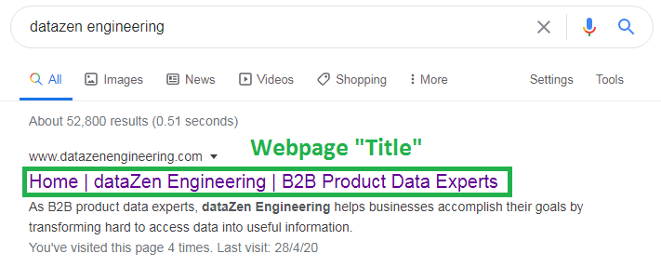
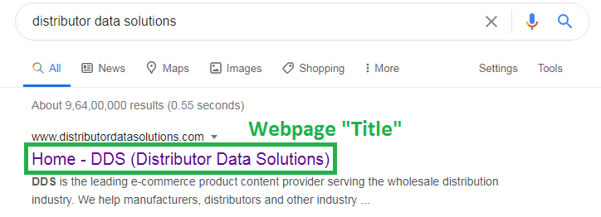
1) Title: (Our Titles are competitively more descriptive and as per SEO recommendation)
​Conclusion: While we have added the following titles in the website pages. Still, if you have any suggestions, please let me know
Home: Home | dataZen Engineering | B2B Product Data Experts
Data Science: Data Science | dataZen Engineering | Data Analytics Experts, Big Data Experts
About us: About us | dataZen Engineering | Product Data Experts, Documentum Experts
Accomplishments: Accomplishments | dataZen Engineering | Software-as-a-Service (SaaS)
Use-Cases: Use-Cases | dataZen Engineering | Data Science, Data Analytics, Big Data, S.A.P.
Events: Events | dataZen Engineering | Idea eBiz, RVCF Conferences, RVCF Webinars
Plans: Plans | dataZen Engineering | E-Commerce, Product Information Management, Price & Availability

Slide 5
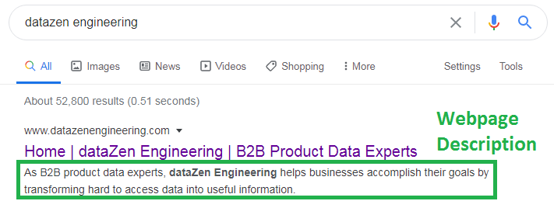
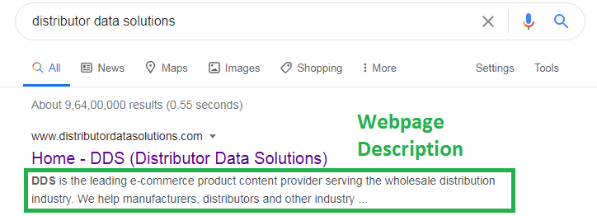
2) Description: (We need to modify webpage description)
Description is a 50-300 characters (including spaces) summary of our whole webpage. It should contain all the "core business related words" which is present in our homepage headings, subheadings and paragraphs.
Google search engine searches website with the help of "Keyword" and "Description". Our "Description" is good but for becoming visible in google search we need to add "targeted words" in our description.
If you see DDS description, they have added "e-commerce", "product content provider", "wholesale distribution", "manufacturers" and "distributers".
So if somebody searches a "google query" like "electrical product content provider for e-commerce in USA" then (DDS) will got benefit of it because
product content provider word is present in their description. So we also need to add our "core business related words" in our description.
Right now, we have same description in every webpage but for targeting more "keywords" we need to write unique description for every webpage. SEO guidelines also tells to write unique description for every page.
​Conclusion: While we have added the page description in the website pages. But we need to write unique page description for every page.

Slide 6
3) Keywords: (We need to find out top 5 keywords by which people search us on google)
Keyword is a 70 word (maximum) query which is the most important factor in the "Google SEO". Earlier we were targeting 1 to 3 words keywords i.e. “Short Keywords”, but “Short keywords” did not give us desired results because the SEO competition for “Short keywords” is very high so it only benefit to the websites which are already popular on the internet. Once our website got so many visitors then we can also use "Short keywords" like below:
data services | product content syndication | e-commerce data | data science
data as a service | software as a service | ecommerce DaaS | manage e-commerce data
product data syndication | software development | manufacturer syndication | product information
product information | electrical distribution | data analytics | product information management
product information management | electrical product information | big data analytics | product content management
But for now, we need to focus on 4 to 12 words “Long Tail Keywords”. Which “Business professionals” and “Customers” use to search in Google.
Wix platform give us facility to use "5 primary keywords and as many as secondary keywords", Currently, we have put following 5 primary "Long Tail Keywords" in our website:
from where can I get product information list of schneider electric US.
data services provider for electric product data in US.
where can I get syndicated product data of schneider electric US
electrical product data syndication companies near me
data services provider near me
​Conclusion: While we have added the above 5 keywords (i.e. primary keywords), but we need to plan and modify them also we need to add "secondary longtail keywords" with the combination of above (20 short keywords) which customers search on google to find companies like us.

Slide 7
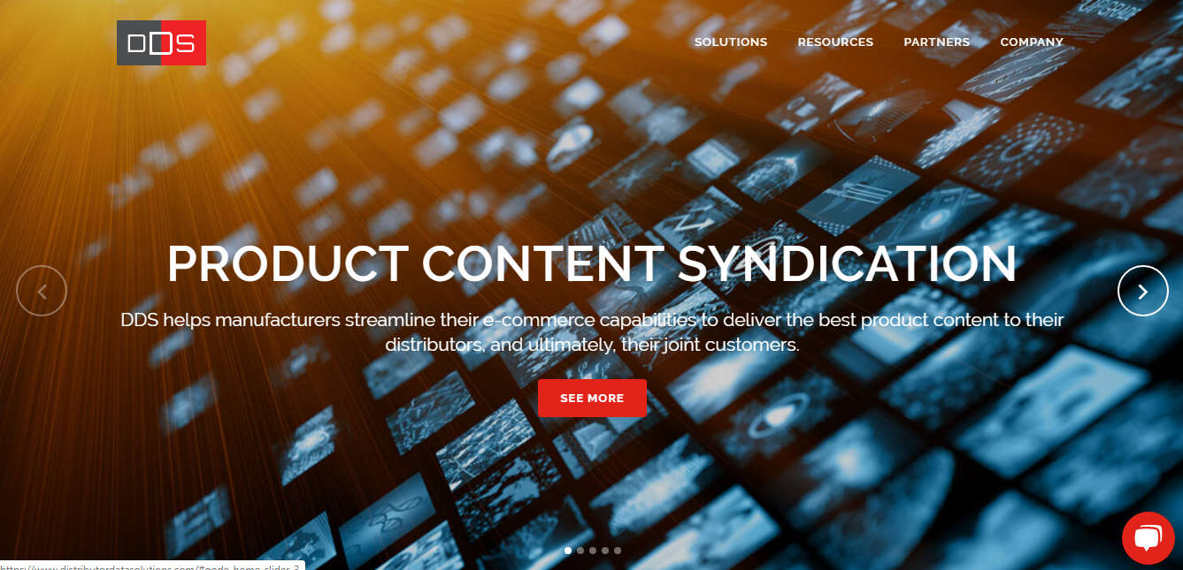
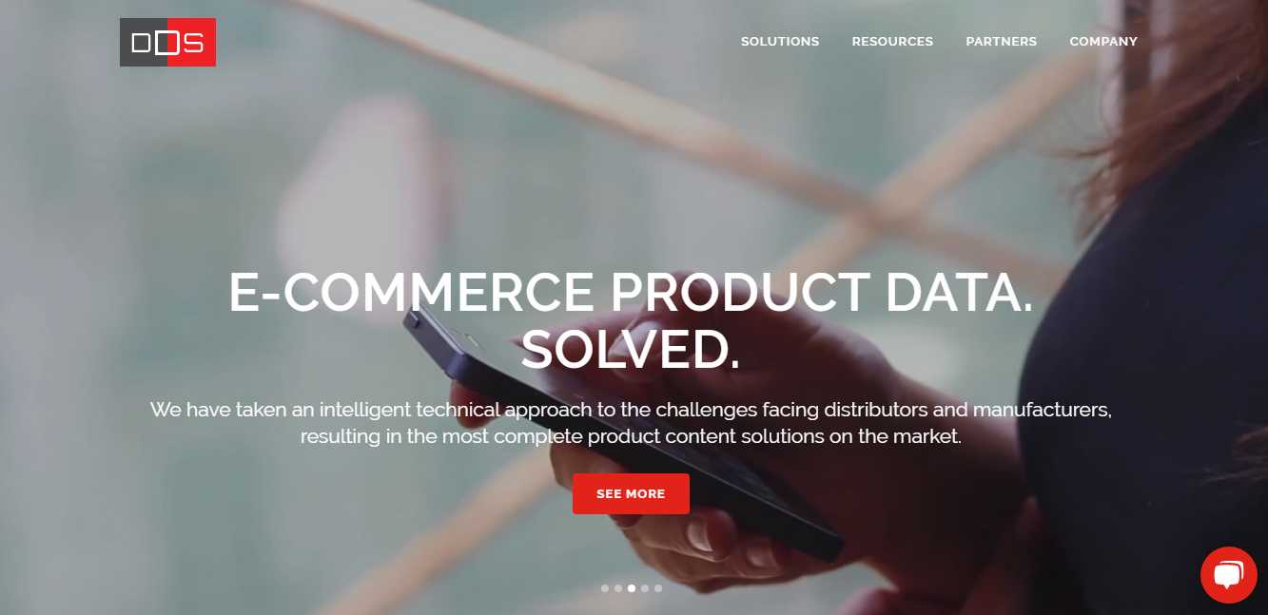
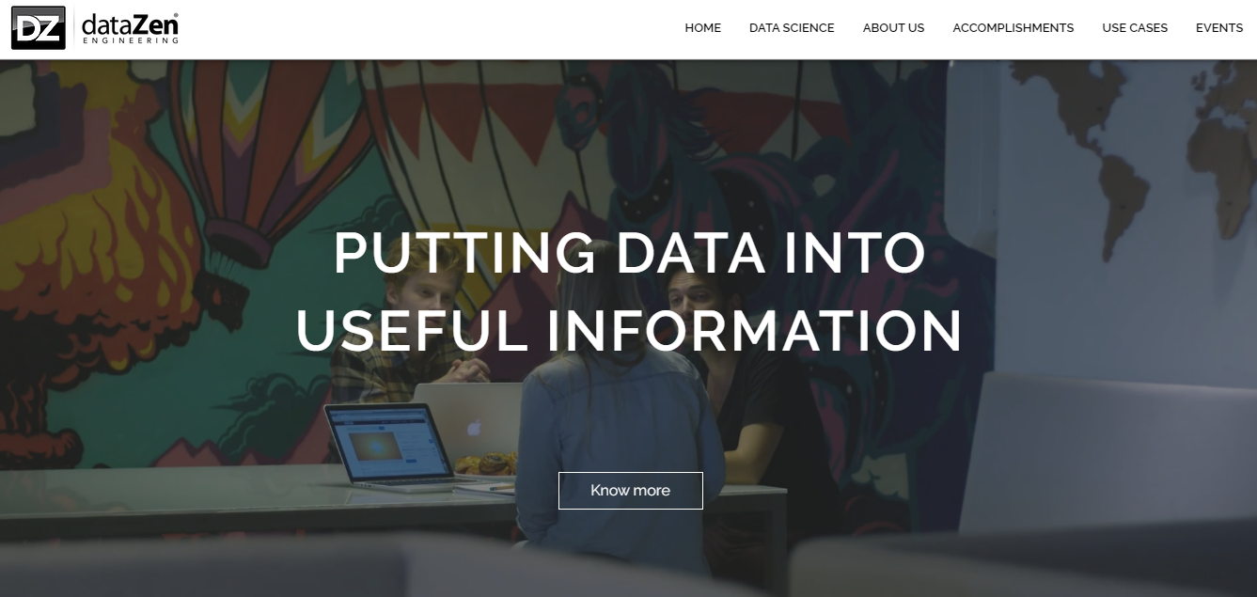
4) Headings:
Heading is the first text of our homepage. It is one of the very important factor in SEO. When a user search a "keyword" in google. Then google matches that "Keyword" with "Page Description" and then with "Page Headings". As we see on the above two examples of DDS, they put "Product content syndication" and "E-commerce product data" in "Keyword", "Page Description" and in "Page Headings".
As our heading is "Putting data into useful information". So as per customer point of view they don't enter these keyword while searching for a services providing company.
​Conclusion: So we should also write and add these kind of business specified headings in our webpage.

Slide 8
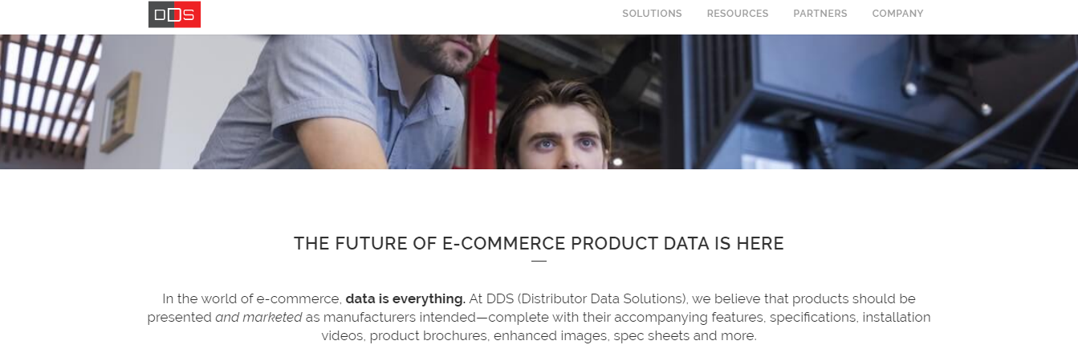
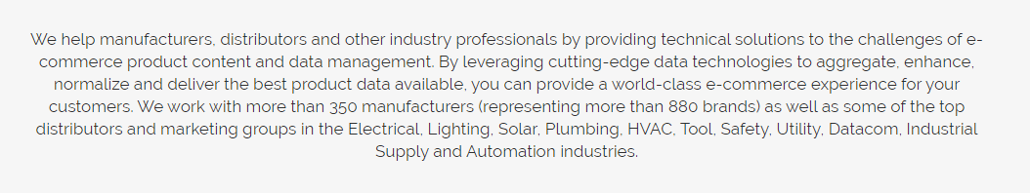
5) Paragraphs:
In the above example we can see that on the Homepage of DDS they elaborated their services, And they have included "keywords" in between their paragraphs.

Slide 9
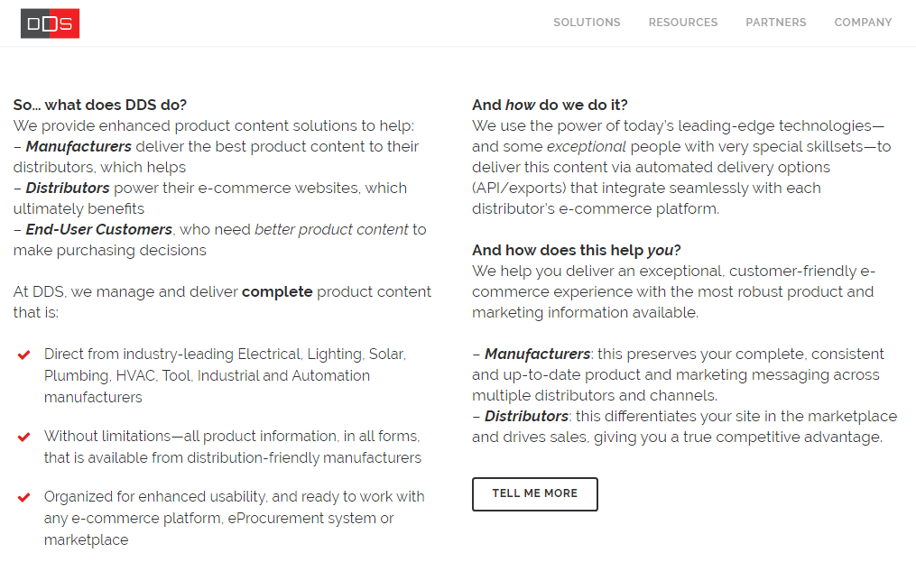
Paragraph is one of the most important factor in SEO. When a user search a keyword then google inspect if any of the part of keyword is present in the "description", "heading" and "paragraph". If "Google" finds everything is in the synchronization then only it increase that website's credit and it appears in the search results. As we see the above example of DDS we will see that they have used almost all the common keywords in their paragraphs like "Electrical", "Manufacturers", "Distributers", "E-Commerce" and "Product content" etc.
​Conclusion: So we should write rich content including our core business terminologies.

Slide 10
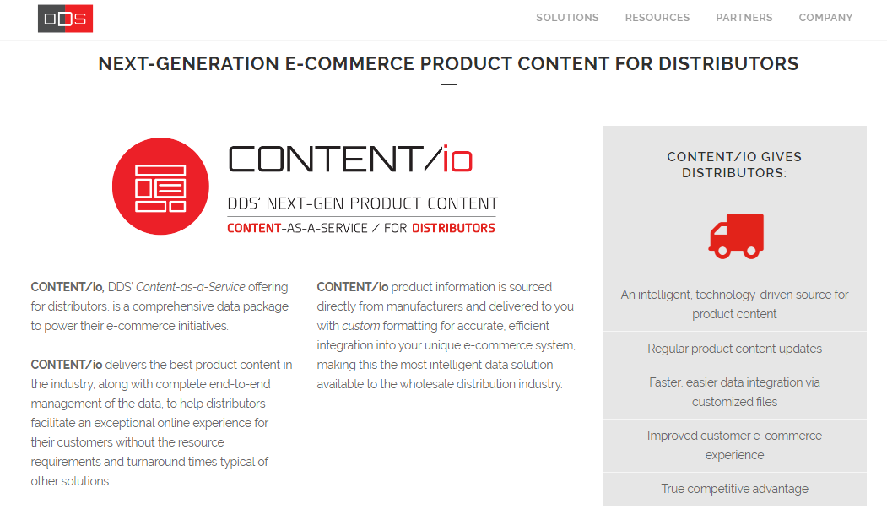
6) Separate details pages for dataZen BSL™ as well as for other services we are offering:
In the below example we can see that DDS has made a separate webpage for their product (content i/o) … So I think we should also make separate pages for dataZen BSL™ and other services we are offering.
​Conclusion: we need to make separate pages for our products and services.

Slide 11
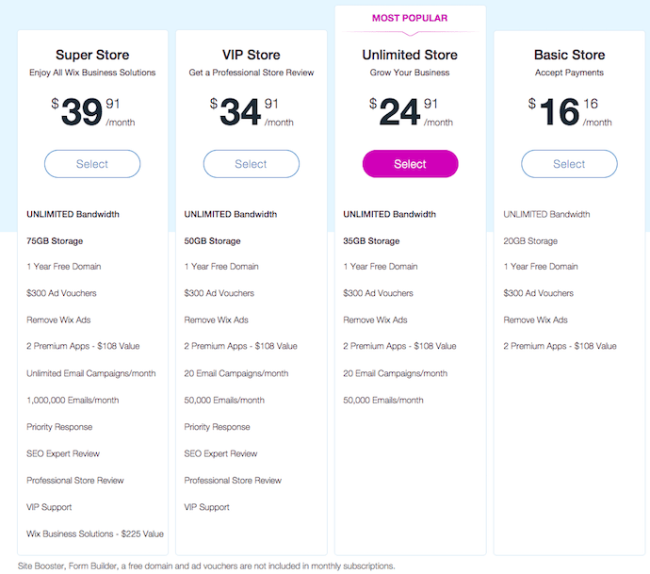
7) Plans page should contain a detailed plans comparison table:
In the plans page we have written text content and images but we should add a detailed comparison table like below (however we will not show pricing in it but we will show what kind of product data we will offer in each plan).
​Conclusion: we need to add a detailed plans comparison table.

Slide 12
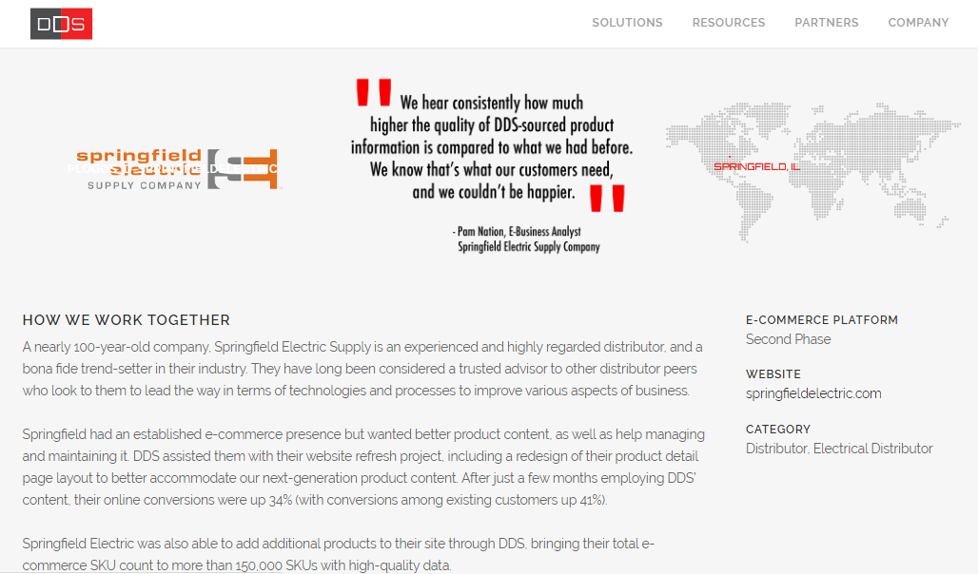
8) Separate customers portfolio section:

Slide 13
Separate customer portfolio section helps a lot in the SEO. In this section we describe what our client do?, how is our relation with our client?, what we did for our client?, For example, if somebody need xyz thing which our clients sell and the user search it on google then redirect to our client's website through our website. By this method we can get lots of benefits.
1) when we made separate page for our clients then we will contact them and say "hey ! We have made separate portfolio page of yours in our website". By this way our old relations with that clients will become refresh. Then we will ask them if they can say some words for us. If they do then we can add those feedback for us under that portfolio page.
2) If we give their website's link in our website then they may also give our website link in their website (which is called back links in terms of SEO).
3) If someone search our customer name in the google search so there might by chance that the customers portfolio present on our website appear in the search results. So if google user click on customer's portfolio present on our website then he will automatically enter our website .Then that person will check our other pages too. It will increase our website visitors.
Below is example of how DDS has made portfolio section.
https://www.distributordatasolutions.com/portfolio_page
Below is the example of springfield electric supply company portfolio:
https://www.distributordatasolutions.com/portfolio_page/springfield-electric-supply-company/
​Conclusion: we need to make separate pages for our products and services.

Slide 14
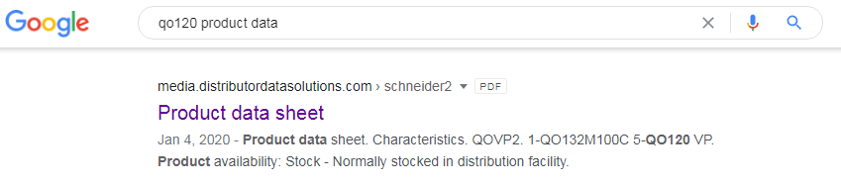
9) Write articles regarding top selling products (e.g. QO120) and product data (IDW, Trade services etc.):
Writing some short articles/paragraphs about top selling products also help. For example if somebody search "QO120 product data" then our written article/information/document might also be appear in google search results.
In the case of DDS, they have uploaded PDF documents of product data on their site. So if you see search "QO120 product data" on google then their website link also appear in the search results.
This is the link:
https://media.distributordatasolutions.com/schneider2/2019q4/d5d784c87b28089da638efc1c3fcb8d012150acb.pdf
Also we should write small paragraphs or some short article about IDW , Trade services and other product data related terminologies. Because the benefit of this thing will be whenever someone search queries related to IDW , trade services etc. then there is a chance that our website will appear in the search results.
​Conclusion: we need to write article on it.

Slide 15
10) Backlinks
Backlinks are the links used for referral/redirect of one website to the other website. For example if somebody wrote an article and they give our website's link to read more about that article so that referring link will be count as one "Backlink". The more backlink we have the more visitors we will get. Quality of backlinks also matter , a single backlink from a very popular website has more weightage than the sum of hundreds of backlinks from less popular websites .
Si, for showing website in top pages in the google search backlinks are the very important factor.
There are three ways of earning backlinks:
1) Social method : In this method websites give reference of each other in their articles. For example below website has given link of DDS:
http://www.canadianelectricalwholesaler.ca/latest-news/1884-what-is-good-product-content
2) Buy backlinks method: There are several companies which purchase domains in bulk, they make many single page web sites and give reference of their clients in those websites. Below is the DDS example: (While I am not sure if they are paid backlinks but they looks like alien domains)
https://www.linkddl.com/site/distributordatasolutions.com
https://www.sitelinks.info/snap36.com/
3) Marketing consultant blogs method: DDS get most of their website views from this method. There are marketing blogs which refers you in their website. DDS has most view from https://electricaltrends.com/ , even they show DDS advertisement in it.
​(Conclusion: we need to work on backlinks.

Slide 16
11) Increase Page Load Speed, Decrease Bounce rate:
People are too impatient these days. When they feel that website is taking much time to load they go back to google and visit another website. So page load speed is also a very important factor in SEO. Light weight things should be on upper side and heavy loaded things should be in lower part of the website. Specially websites home page. It should not be loaded with bulky videos and lots of images. If this happens then website bounce rate increases. Website bounce rate means the rate of people not sticking with our website. The less bounce rate the better it would be for a website. So when I analyzed our website bounce rate so I found it was high which is not good so I analyzed it's page load speed so I found it takes too much time to load as well as it is taking much downloading data which is also not good specially if the user is browsing from mobile phone as it has limited data. So I found that we need to work on the following things to speed up our home page.
1) The first thing which appears on the webpage is the banner of the webpage. As the webpage is load from top to bottom so It should be light weight and there should something to read on the banner so that user will read it until the bottom content gets fully loaded. In DDS example they have put three rotational slides, they are light weight then video and they engage user until the bottom contents get loaded completely. This method will increase page speed and decrease bounce rate.

Slide 17
Conclusion: As we have put video on the banner and single phrase on the banner so it is taking much time to load webpage and it is not engaging users until bottom content loaded. So we should also use the slideshow method like DDS did.​

Slide 18
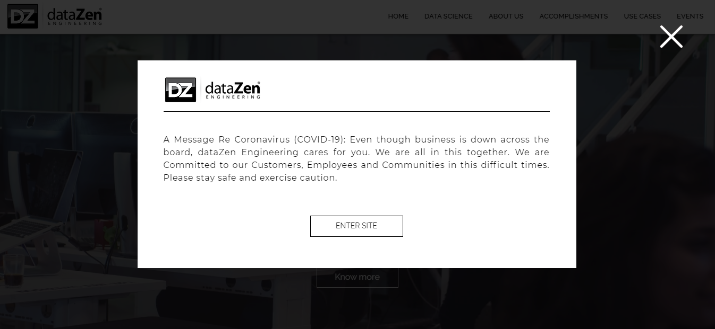
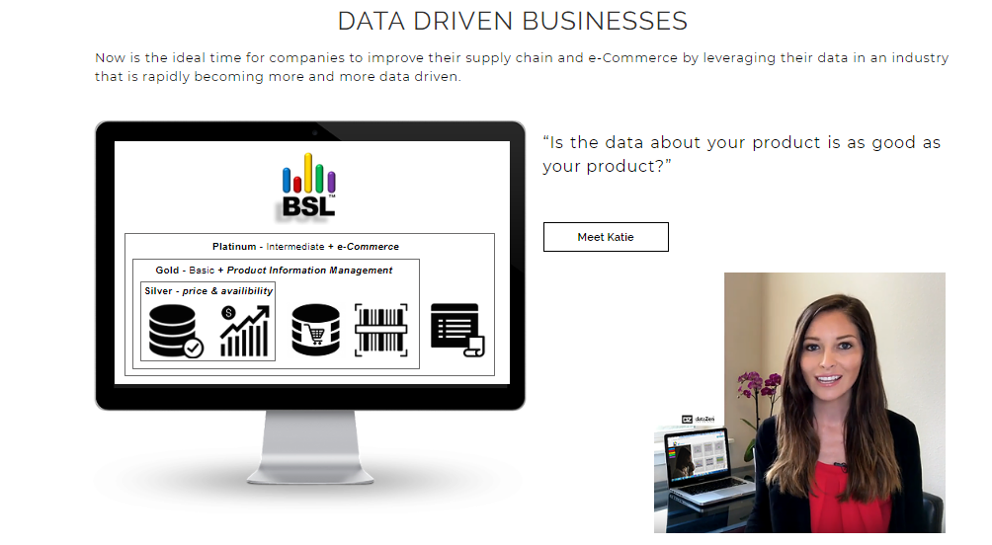
A Message Re Coronavirus (COVID-19): Even though business is down across the board, dataZen Engineering cares for you. We are all in this together. We are Committed to our Customers, Employees and Communities in this difficult times. Please stay safe and exercise caution.
Also we should remove Covid19 warning from popup and put it inside page like this. Because it is slowing down the speed.

Slide 19

12) Travel agency method:
Suppose a person get bored of his daily routine. He searched "What to do get refreshment in life?" He got an article from xyz website that "travelling is a good way to get refreshment in the life". Now he decided to travel. Now he searched where to trave?l then the same xyz website has an article called "top place to visit". He read that article and decided where to travel. Now he searches for affordable travel package. So when he search so in the list of so many websites he will visit that xyz website because it helped him. So a trust built between them. Now a web user converts in to customer. By this method we can also increase our conversion rate. For it need to write articles about our products , ecommerce product data, manufacturers, distributers,
supply chain, electrical industries , terminologies like product data syndication, IDW, trade services QO120 etc

Slide 20
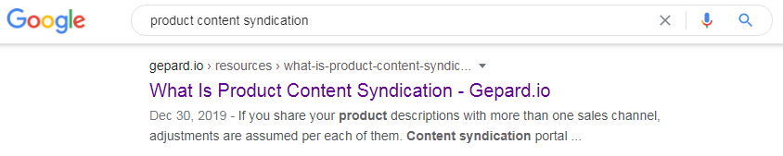
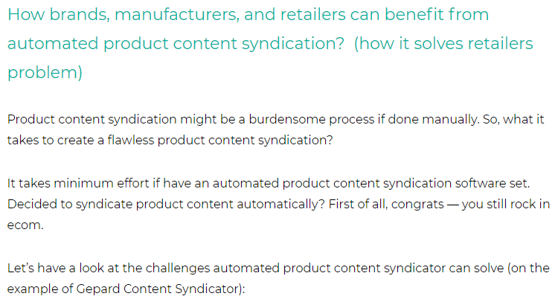
13) Keyword flow and
Ideal website structure:
Browser
Keyword
Title
Description
Web Page
Heading
Paragraph
Conclusion: Just observe how "Product content syndication" is present in everything. This is called an ideal SEO page. Google lift up these kind of pages in the search results.

Slide 21
Conclusion
1) Title:
​Conclusion: While we have added titles in the website pages. Still, if you have any suggestions, please let me know.
2) Description
​Conclusion: While we have added the page description in the website pages. But we need to write unique page description for every page
3) Keywords
​Conclusion: While we have added the 5 keywords (i.e. primary keywords), but we need to plan and modify them also we need to add "secondary longtail keywords" with the combination of (short keywords) which customers search on google to find companies like us.
4) Headings
​Conclusion: We should also write and add business specified headings in our webpage.
5) Paragraphs
Conclusion: We should write rich content which includes our core business terminologies.
6) Separate details pages for dataZen BSL™ as well as for other services we are offering
Conclusion: We need to make separate pages for our products and services.

Slide 22
7) Plans page should contain a detailed plans comparison table
​Conclusion: we need to add a detailed plans comparison table.
8) Separate customers portfolio section
​Conclusion: we need to make separate pages for our products and services.
9) Write articles regarding top selling products (e.g. QO120) and product data (IDW, Trade services etc.)
​Conclusion: we need to write articles on it.
10) Back links
​Conclusion: we need to work on it.
11) Increase Page Load Speed, Decrease Bounce rate
Conclusion: As we have put video on the banner and single phrase on the banner so it is taking much time to load webpage and it is not engaging users until bottom content loaded. So we should also use the slideshow method like DDS did.​
12) Tours agency method
​Conclusion: We need to follow writing pattern of tours agency.
13) Keyword flow and Ideal website structure
​Conclusion: We need to follow this pattern to be in google search results.

Slide 23
Thank You

